Slide 1
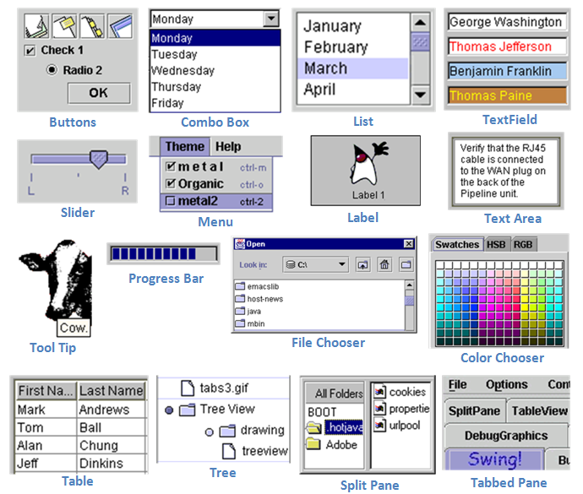
GUI Swing Components

Slide 2
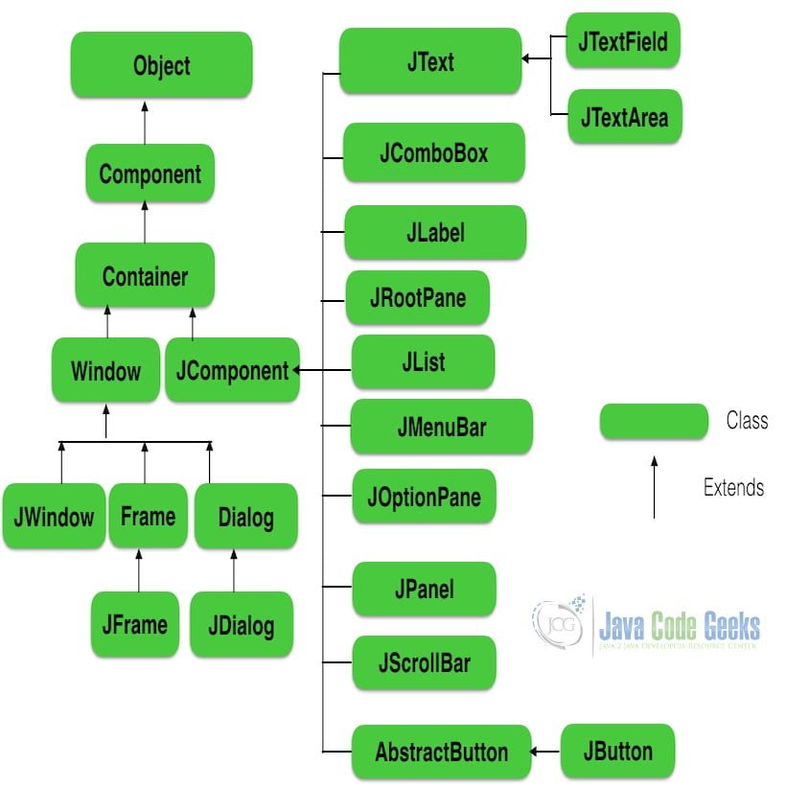
Javax.swing components

Slide 3
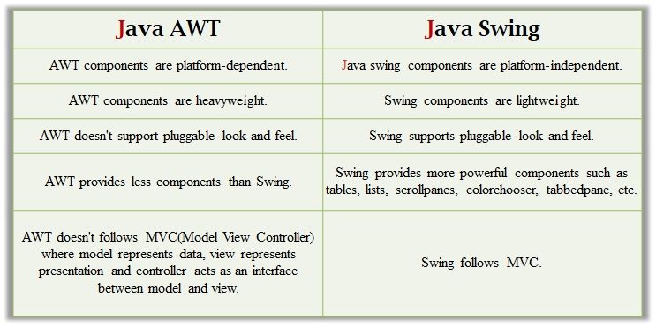
AWT(Abstract window Toolkit) Vs. Swing

Slide 4
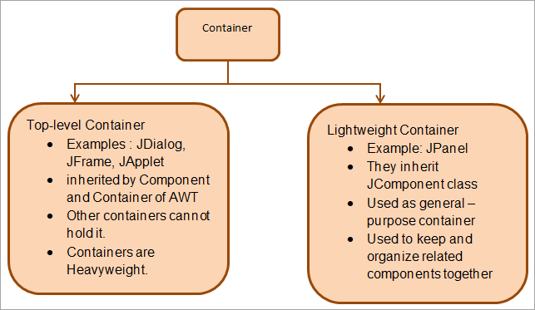

Slide 5
Container
Container
The Container is a component in AWT that can contain another components like buttons, textfields, labels etc. The classes that extends Container class are known as container such as Frame, Dialog and Panel.
It is basically a screen where the where the components are placed at their specific locations. Thus it contains and controls the layout of components.

Slide 6
Types of containers
Window
Panel
Frame
Dialog
Window
The window is the container that have no borders and menu bars. You must use frame, dialog or another window for creating a window. We need to create an instance of Window class to create this container

Slide 7
Types of containers
Panel
The Panel is the container that doesn't contain title bar, border or menu bar. It is generic container for holding the components. It can have other components like button, text field etc. An instance of Panel class creates a container, in which we can add components.
Frame
The Frame is the container that contain title bar and border and can have menu bars. It can have other components like button, text field, scrollbar etc. Frame is most widely used container while developing an AWT application.

Slide 8
Java Layout Managers
The LayoutManagers are used to arrange components in a particular manner. The Java LayoutManagers facilitates us to control the positioning and size of the components in GUI forms. LayoutManager is an interface that is implemented by all the classes of layout managers. Some of the following classes that represent the layout managers:
ava.awt.BorderLayout
java.awt.FlowLayout
java.awt.GridLayout
java.awt.CardLayout

Slide 9
Java BorderLayout
The BorderLayout is used to arrange the components in five regions: north, south, east, west, and center. Each region (area) may contain one component only. It is the default layout of a frame or window. The BorderLayout provides five constants for each region:
public static final int NORTH
public static final int SOUTH
public static final int EAST
public static final int WEST
public static final int CENTER

Slide 10
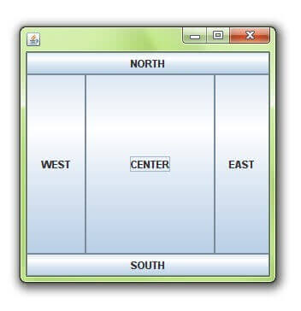
Java BorderLayout

Slide 11
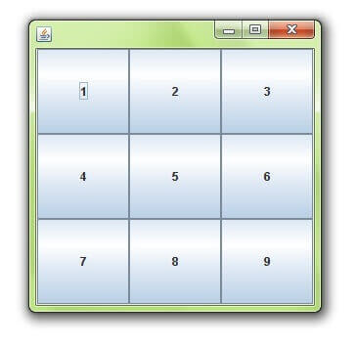
Java GridLayout
The Java GridLayout class is used to arrange the components in a rectangular grid. One component is displayed in each rectangle.
(3, 3) – Grid

Slide 12
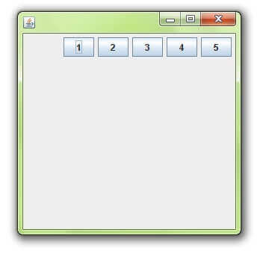
Java FlowLayout
the Java FlowLayout class is used to arrange the components in a line, one after another (in a flow). It is the default layout of the applet or panel.Allignment of flowlayout are :
public static final int LEFT
public static final int RIGHT
public static final int CENTER

Slide 13
Java CardLayout
The Java CardLayout class manages the components in such a manner that only one component is visible at a time. It treats each component as a card that is why it is known as CardLayout.
Commonly used methods are as follows :
public void next(Container parent): is used to flip to the next card of the given container.
public void previous(Container parent): is used to flip to the previous card of the given container.
public void first(Container parent): is used to flip to the first card of the given container.
public void last(Container parent): is used to flip to the last card of the given container.
public void show(Container parent, String name): is used to flip to the specified card with the given name.

Slide 14
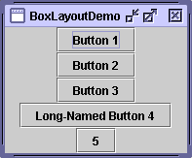
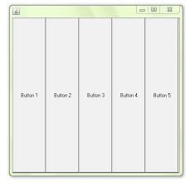
Box Layout
The Java BoxLayout class is used to arrange the components either vertically or horizontally.
For this purpose, the BoxLayout class provides constants like X_AXIS, Y_AXIS, etc..

Slide 15
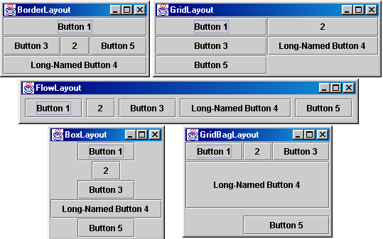

Slide 16
Event
Changing the state of an object is known as an event. For example, click on button, dragging mouse etc. The java.awt.event package provides many event classes and Listener interfaces for event handling.
Event Handling is the mechanism that controls the event and decides what should happen if an event occurs. This mechanism have the code which is known as event handler that is executed when an event occurs. Java Uses the Delegation Event Model to handle the events.

Slide 17
Event
In the delegation model, an event is an object that describes a state change in a source.
events generated by interacting directly
• pressing a button
• entering a character via the keyboard
• selecting an item in a list
• clicking the mouse

Slide 18
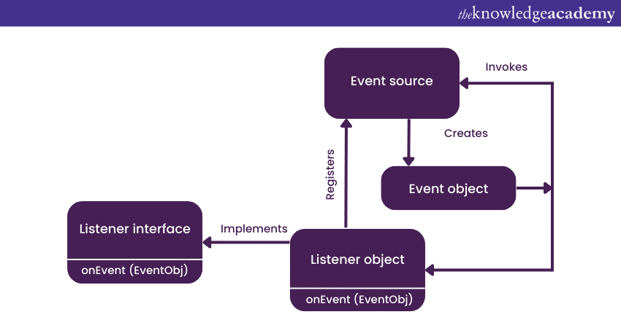
Event Delegation Model

Slide 19
Event Delegation Model
The delegation event model, which defines standard and consistent mechanisms to generate and process events.
Its concept is quite simple: a source generates an event and sends it to
one or more listeners. In this scheme, the listener simply waits until it receives an event.
Once received, the listener processes the event and then returns.
The advantage of this design is that the application logic that processes events is cleanly separated from the user interface logic that generates those events.
In the delegation event model, listeners must register with a source in order to receive anevent notification. This provides an important benefit: notifications are sent only to listeners that want to receive them.

Slide 20
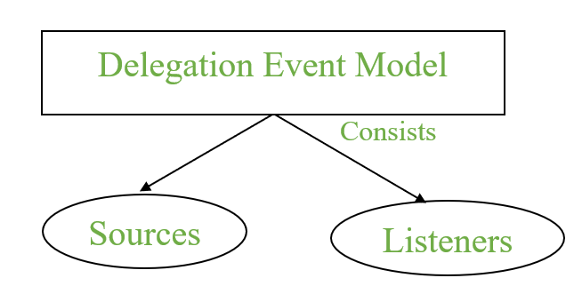

Slide 21
Event Source
A source is an object that generates an event. This occurs when the internal state of that object changes in some way. Sources may generate more than one type of event.
A source must register listeners in order for the listeners to receive notifications about a specific type of event. Each type of event has its own registration method.
Here is the general form:
public void addTypeListener(TypeListener el)
Here, Type is the name of the event and el is a reference to the event listener.

Slide 22
Listener
A listener is an object that is notified when an event occurs. It has two major requirements.
First, it must have been registered with one or more sources to receive notifications about specific types of events.
Second, it must implement methods to receive and process these notifications.
The methods that receive and process events are defined in a set of interfaces found in java.awt.event

Slide 23
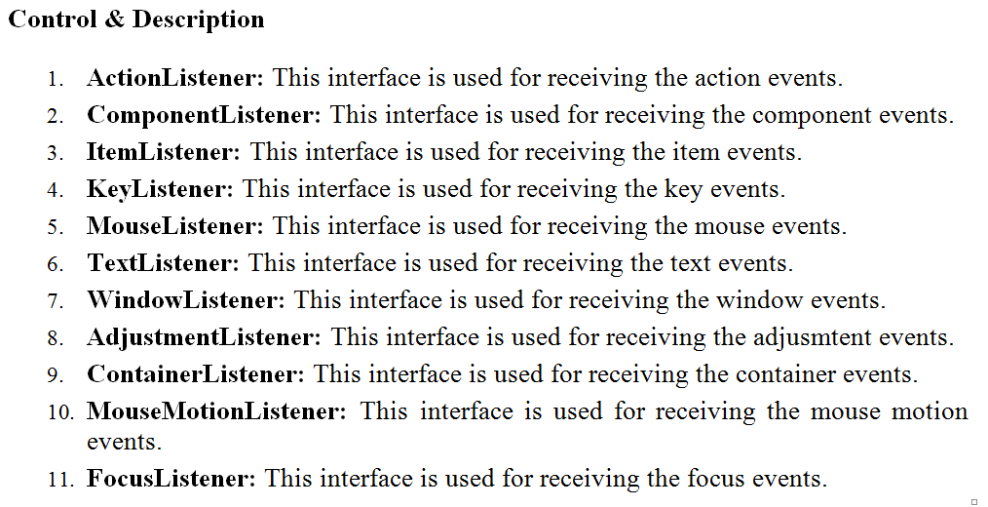

Slide 24
Adapter Class
Java adapter classes provide the default implementation of listener interfaces.
If you inherit the adapter class, you will not be forced to provide the implementation of all the methods of listener interfaces. So it saves code.
Adapter Class is a simple java abstract class that implements an interface with only an empty implementation.

Slide 25
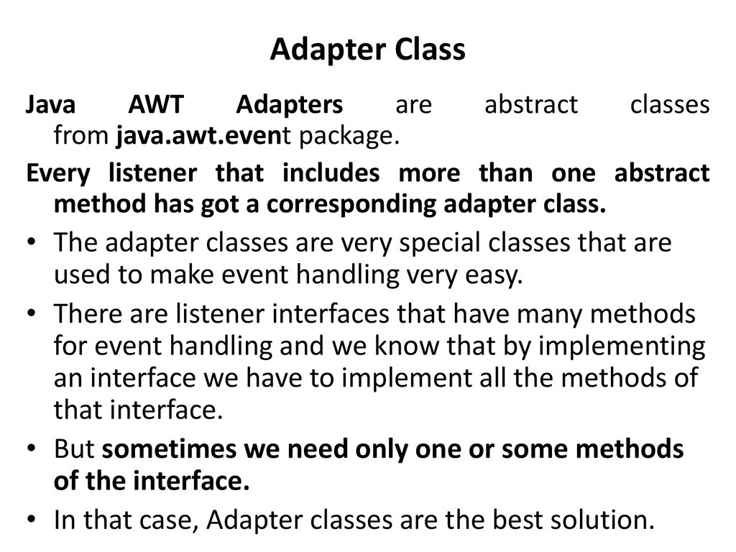

Slide 26
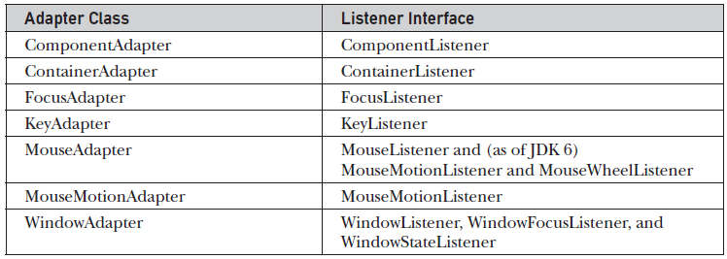

Slide 27
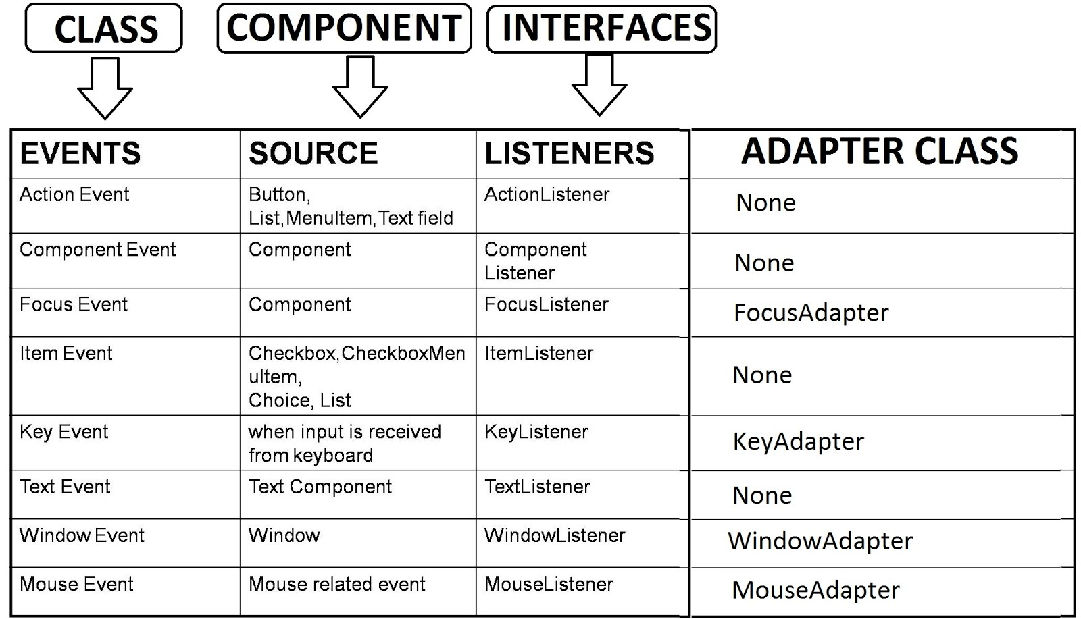

Slide 28
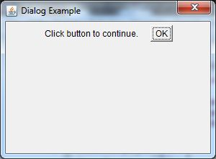
Dialog
The Dialog control represents a top level window with a border and a title used to take some form of input from the user. It inherits the Window class.
Unlike Frame, it doesn't have maximize and minimize buttons.Frame and Dialog both inherits Window class.

